Slide 1
Kennedy Assassination
Cutting through Conspiracies

Slide 2
November 22, 1963
JFK was in Dallas trying to get support for next year’s election.
Dallas had an unfriendly reputation towards politicians.

Slide 3
Lee Harvey Oswald
Shown here in Oak Cliff, Texas.
Tried to defect to the Soviet Union and Cuba.

Slide 4
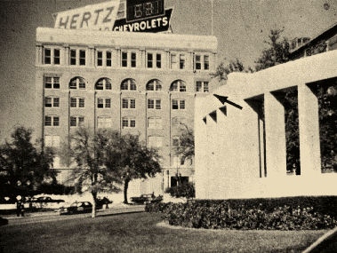
School Book Depository
LHO got a job in this building. He would eventually shoot JFK from the sixth floor.

Slide 5
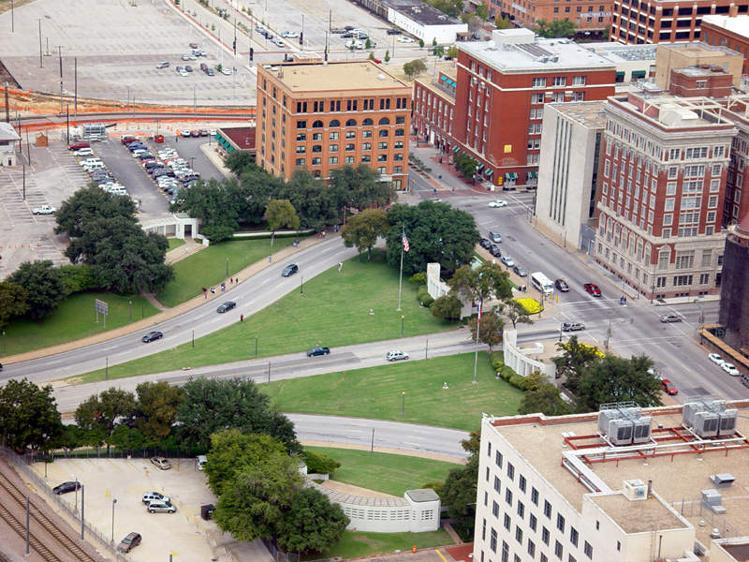
6th floor

Slide 6
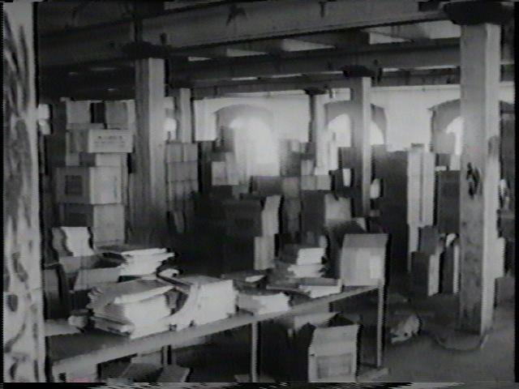
Sixth Floor of the School Book Depository

Slide 7
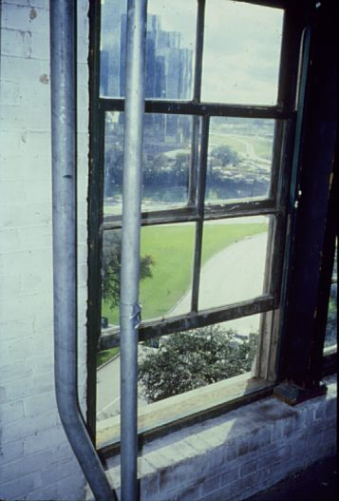
Sniper’s perch
This is Lee Harvey Oswald’s view from the 6th floor of the School Book Depository

Slide 8
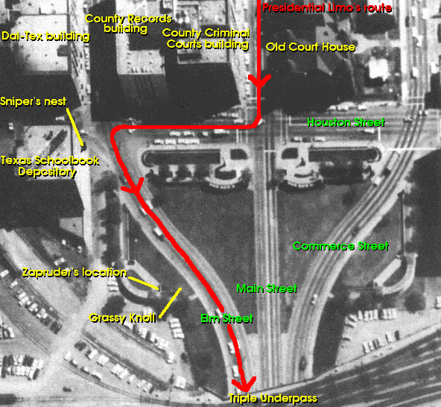

Slide 9
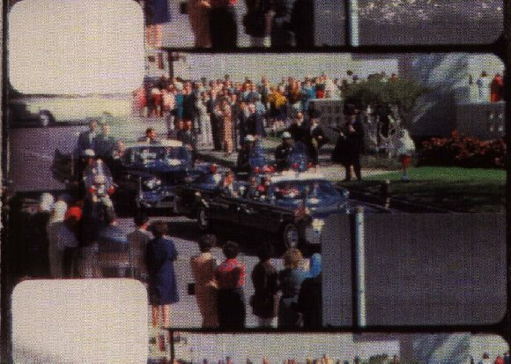
Zapruder’s film was the most famous evidence

Slide 10
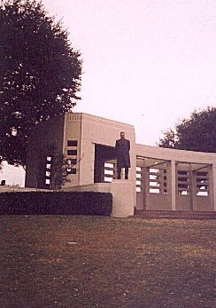
He was filming from here.

Slide 11
Sniper perch
1st shot
3rd shot
Notes:
4 out of 178 witnesses claimed to hear shots coming from multiple directions

Slide 12
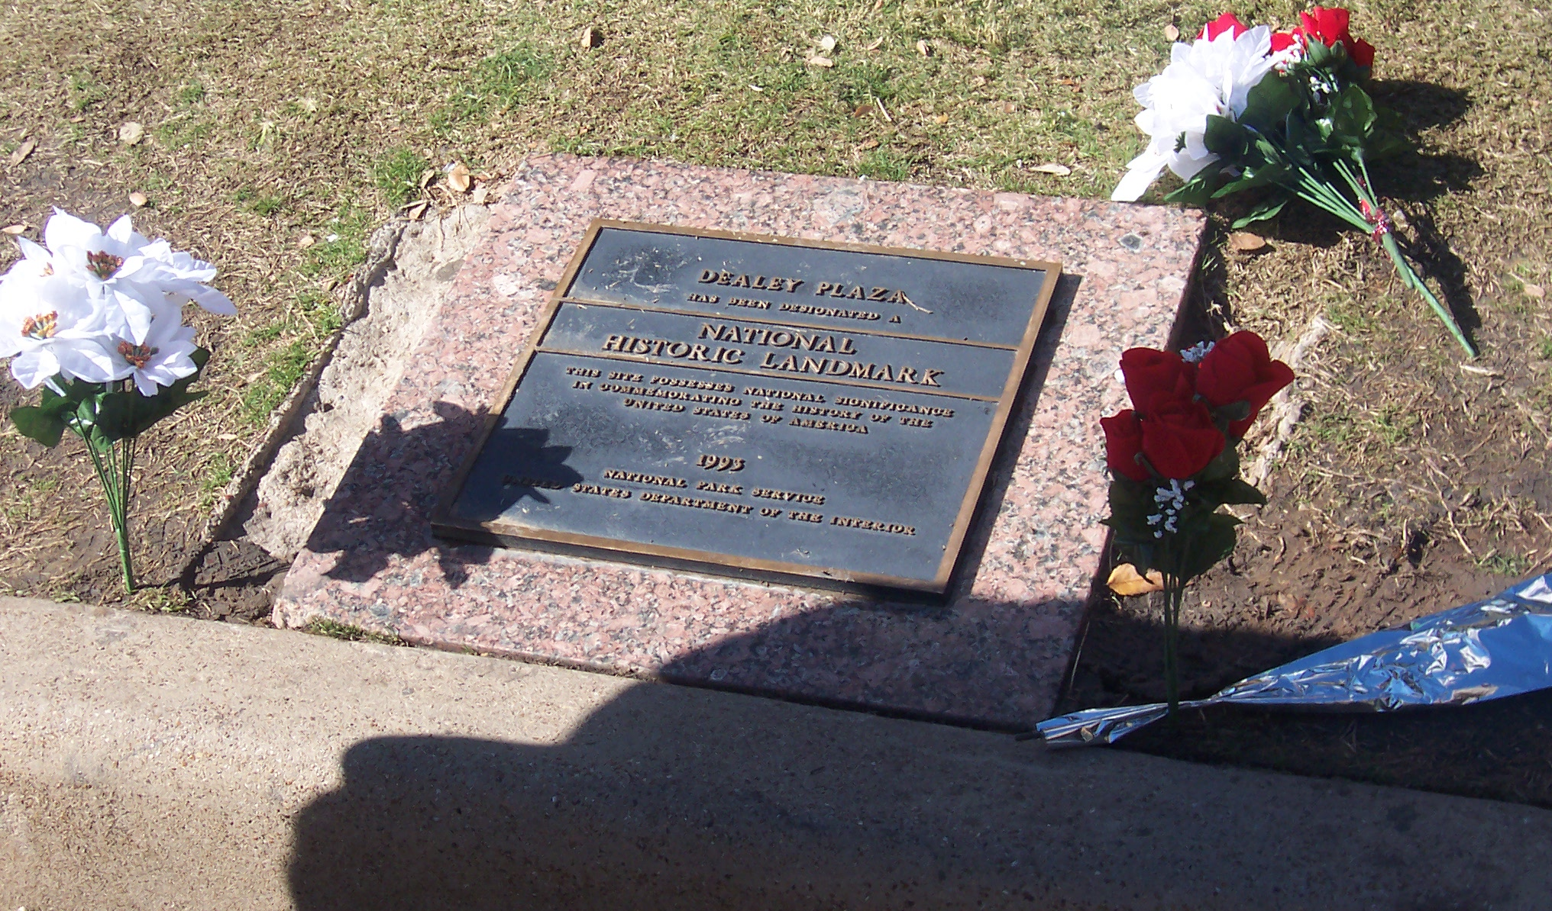
This plaque sits next to where he was fatally shot.

Slide 13
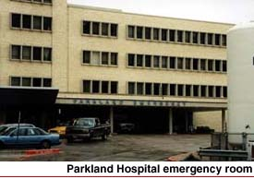
Kennedy was rushed to Parkland

Slide 14
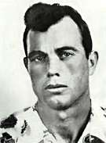
Oswald fled the scene
He checked into his boarding house on 1026 Beckley.
Officer J. Tippit stops on the street to talk to Oswald.
Oswald shoots him 4 times to death

Slide 15
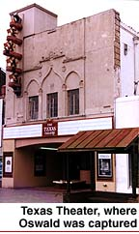
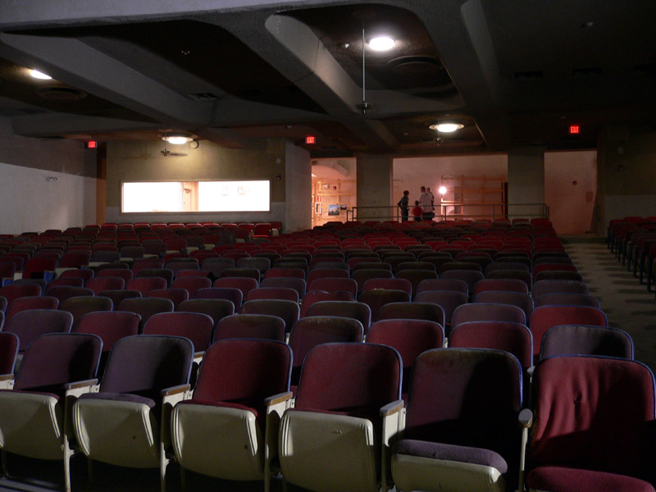
Lee Harvey Oswald walked 8 blocks to Texas Theatre on Jefferson Blvd.

Slide 16
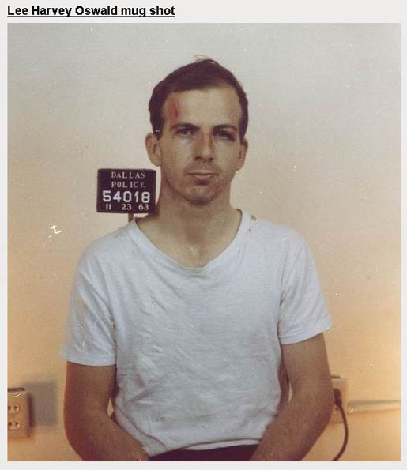
Arrested
The Cops beat him up after Oswald resists arrest at the theatre.

Slide 17
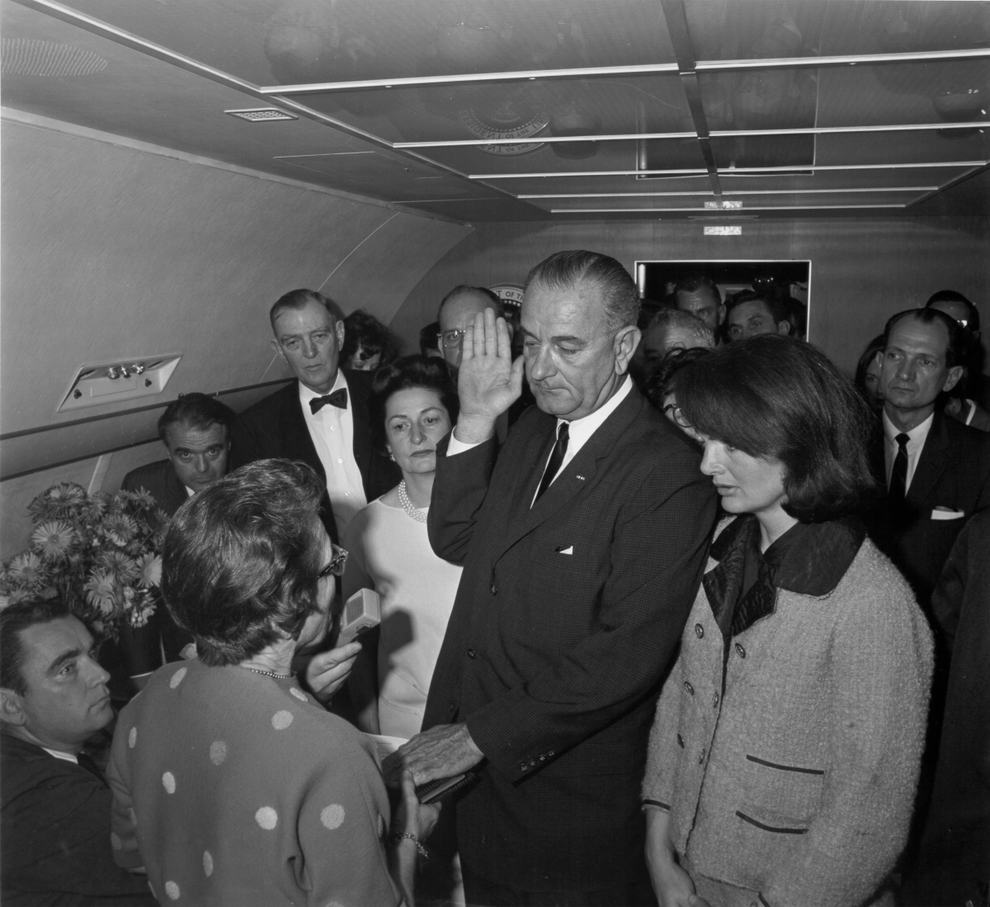
LBJ was sworn in at Love Field

Slide 18
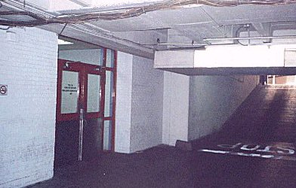
LHO was being escorted to another jail.

Slide 19
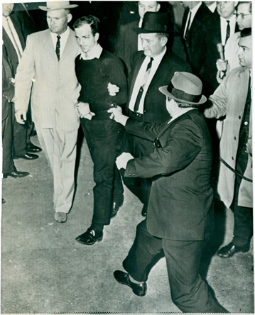
Oswald transferred to another jail.
Jack Ruby, a Dallas nightclub owner, shoots Oswald on live TV.
LHO will never go on record why he did what he did. He is now dead.

Slide 20
LHO killed
“You killed the President, you rat!”

Slide 21
Case Closed?
Oswald fired 3 shots (missed the first one)
The assassination was filmed (Zapruder)
The government investigated the murder for years and concluded that Oswald acted alone.
Virtually no witness at that time gave indication that more than 3 shots were fired at Kennedy.
However. . . .

Slide 22
80% of people today
believe JFK was killed
by someone else!!!!

Slide 23
Composite Conspiracy Story
JFK was killed by a conspiracy of high government officials with LBJ working with the CIA, the mafia and anti-Castro Americans who all want revenge for Kennedy’s lack of support in the failed Bay of Pigs invasion of Cuba. At the same time (in contradiction), Castro killed JFK with Russia’s help. Jack Ruby killed LHO so he wouldn’t talk. Ruby died with a deep, dark secret!

Slide 24
Let’s keep in mind
Many people thought Elvis was alive for decades after his death.
Many people think Tupac Shakur is alive.
Many people think that NASA never landed on the moon.
Many think Bush let 9-11 happen on purpose.

Slide 25
To make matters worse. . .
Oliver Stone made a movie called JFK in 1992.
The movie is full of errors, lies and bad science.

Slide 26
Stone’s JFK helped advance these falsehoods about the assassination:
Oswald could not have shot JFK from the sixth floor in less than 6 seconds.
Kennedy was shot from the front by gunmen on the grassy knoll.
Jack Ruby killed Oswald on orders from the mafia to keep Oswald quiet about everything.

Slide 27
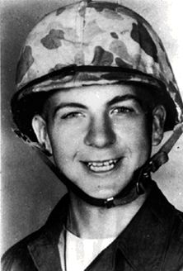
Could Oswald have made those shots?
Yes! Oswald was a sharpshooter trained by the US Marines.
He scored a 212 out of 250 on a 200 yard shooting range.
JFK’s car was only 50 yards away from the sniper’s nest and moved 10mph

Slide 28
Jack Ruby
Conspiracists believe Jack Ruby was a mobster who killed Oswald to silence him.
Ruby died in jail a couple of years later, supposedly with some deep dark secret.

Slide 29
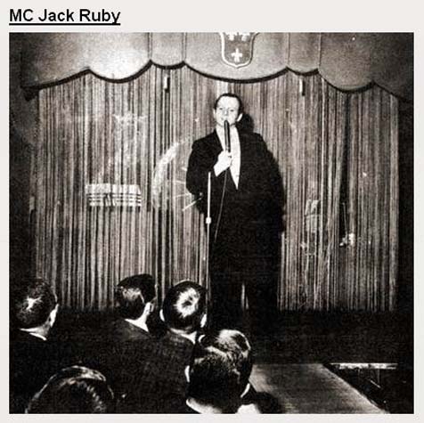
However. . .
Jack Ruby knew gangsters but was not one. (He knew lots of cops too!)
He was a night club owner.
Those that knew him said he couldn’t keep a secret for 2 minutes!

Slide 30
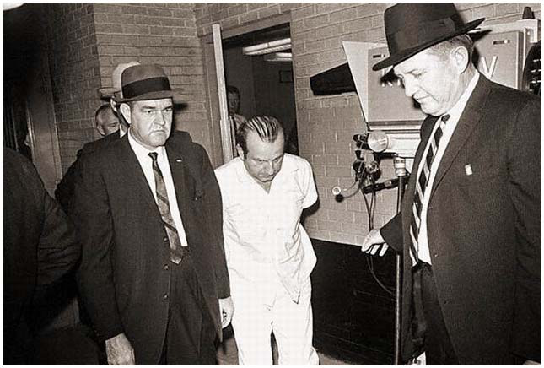
Ruby
Ruby’s assassination was not planned.
Ruby left his dog and his girlfriend in the car when he left to shoot Oswald.
No conspiracy here from Jack Ruby!

Slide 31
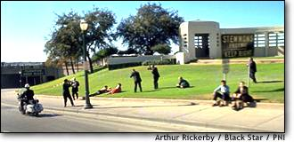
Was Kennedy shot from the front?
2nd assassin?
Zapruder

Slide 32
Back and to the left?
Many assume based on JFK’s bodily motion and blood spray that he was shot from the front.

Slide 33
No witnesses reported gunshots that day!
2nd assassin?
Zapruder
wall

Slide 34
All witnesses that day described shots from where Oswald was
Witness described people
but no shots behind fence
Oswald

Slide 35
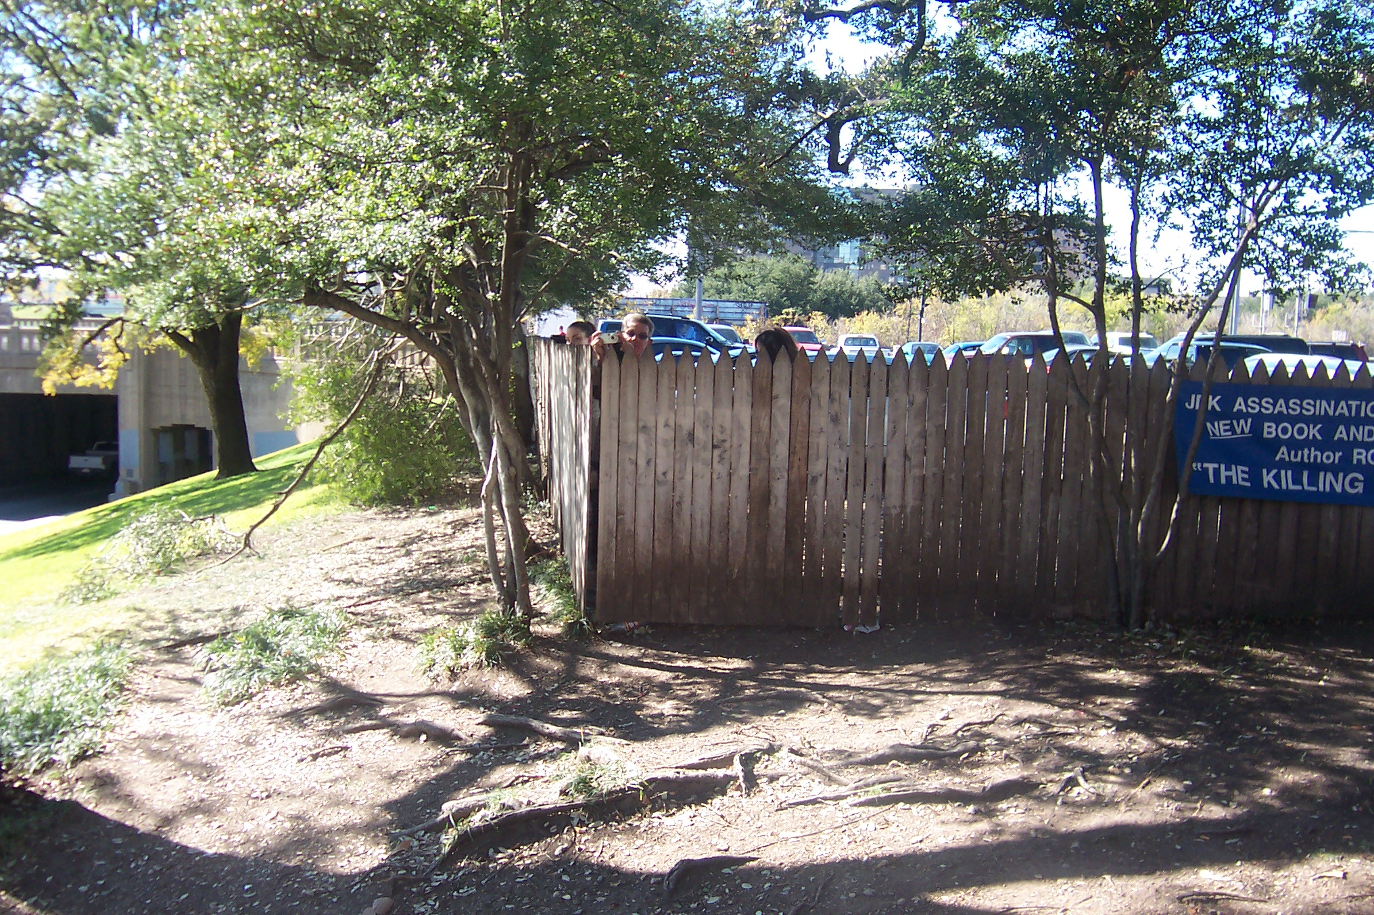
Picket fence

Slide 36
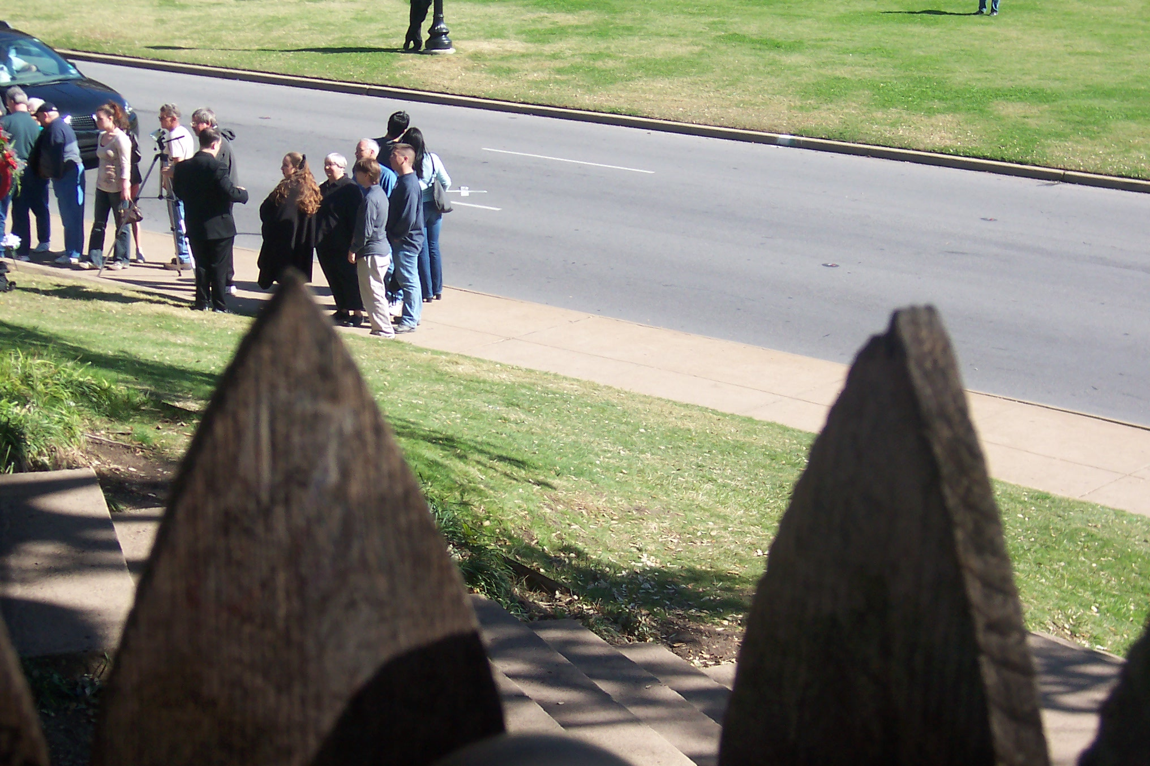
View from behind fence (x marks the spot)
3rd shot

Slide 37
Picket fence shooter theory
There were plenty of witnesses in that area. None reported hearing shots. A few attention seekers claimed they did years later.
The witness behind the fence died in a single car crash 2 years later, festering conspirators' ideas.
Many witnesses have been accused of being a part of the conspiracy, including Zapruder (born in Russia).

Slide 38
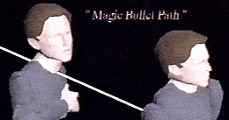
Autopsy
Kennedy was hit in the back of the neck, not the front.
He was hit in the back of the head, not the front.
A shooter could not have hit JFK from the fence without hitting Jackie or her area.

Slide 39
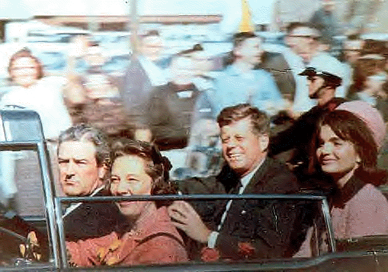
Magic Bullet?
Oliver Stone argued that a single bullet could not have hit JFK and Governor Connally the way reported.

Slide 40
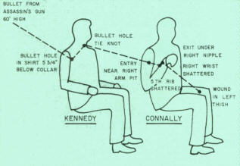
Magic Bullet?
Using the bullet wounds, Stone used this diagram to convince people that one bullet could not hit JFK and the governor the way reported.
Notice both
heads are
level with
each other.

Slide 41
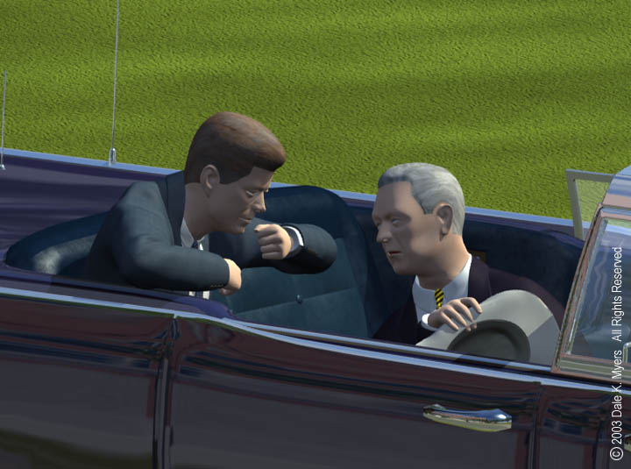
JFK sat elevated above Connally
wrong

Slide 42
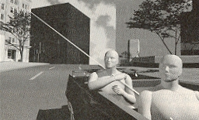
Single Bullet Theory
Once their seats are properly aligned, the single bullet theory appears to be valid!

Slide 43
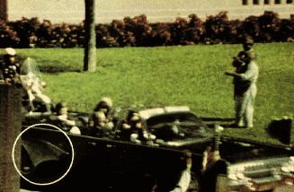
Umbrella Man?
Some say there was a mysterious man fanning an umbrella right as Kennedy was shot. Oliver Stone said he was signaling to shoot JFK.
here

Slide 44
Umbrella Man
Not much mystery here. The man was questioned and identified.
He was trying to heckle JFK with his umbrella in a way that he himself did not quite understand.
One guy told me he was a Soviet agent.
here

Slide 45
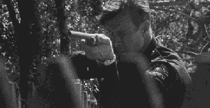
Badge Man?
Was there a mysterious man wearing a badge near the fence?
Again, no shots were fired from this area.
JFK’s entry wounds were in the back of his neck and head.

Slide 46
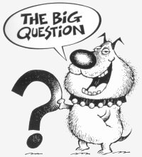
Motives?
Everybody seemed to have a reason to kill JFK if one thinks about it hard enough.

Slide 47
Lyndon B. Johnson
Supposedly, JFK wanted to withdraw from Vietnam.
LBJ had him killed so he could continue the war (supposedly).

Slide 48
LBJ
Kennedy gave no clear evidence of exiting Vietnam.
LBJ showed no desire for escalating this “bitch of a war.” (LBJ’s words).

Slide 49
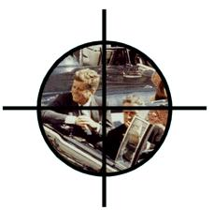
The Mob?
The mob supposedly wanted to murder Kennedy.

Slide 50
Sam Giancana connections
Supposedly upset about JFK’s lack of support for killing Fidel Castro.

Slide 51
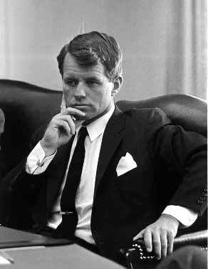
Mob continued
The mob was upset about Robert Kennedy’s pursuit of organized crime.
RFK was the Attorney General (top cop)

Slide 52
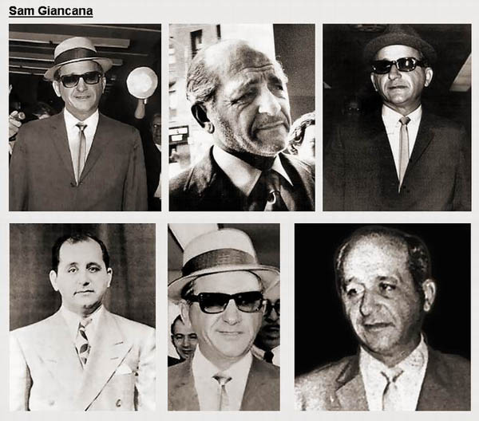
The mafia did not kill JFK
The FBI had the Chicago mafia’s phone tapped and their offices tapped for years before 1963. No evidence was heard.
The mafia had no real interest in JFK. Maybe his brother Robert, but not the President.

Slide 53
Did Mob control Oswald and Ruby?
Oswald was a lone actor, just as he acted alone in an attempted murder of a General Walker.
Ruby knew mobsters, but he was not trusted by them.

Slide 54
Did Castro Kill JFK?
Motive: The CIA tried several times to kill Fidel Castro. Operation Mongoose considered poisoned cigars, poisoned diving suits, mafia rub out.

Slide 55
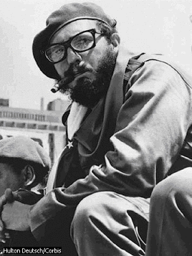
Did Castro kill JFK?
Castro did not have the means to do so.
Castro wanted the US to leave Cuba alone. An assassination would have led to an invasion. (Castro said this.)
Oswald was refused entry into Cuba.

Slide 56
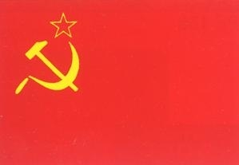
Did the Russians kill JFK?
Motive: The USA was a serious rival in the Cold War. Killing JFK would provide instability in the military and government.

Slide 57
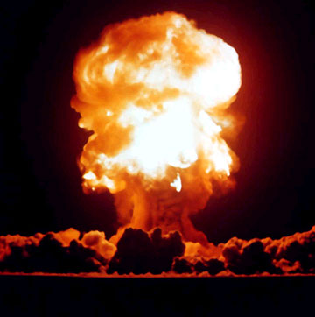
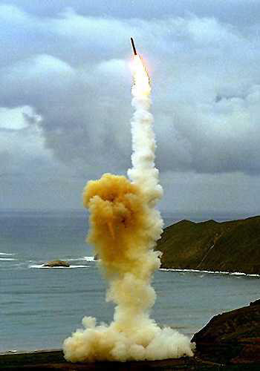
Russians killed JFK?
Why would the Russians risk nuclear war? Having LBJ as President would not have benefited
the Soviets.

Slide 58
Conclusion
People (including me) believe what they want to believe.
Some want to believe JFK was not killed by some lone nut.
Some enjoy being in the minority opinion.

Slide 59
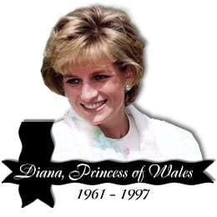
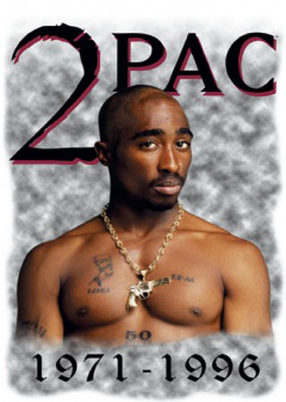
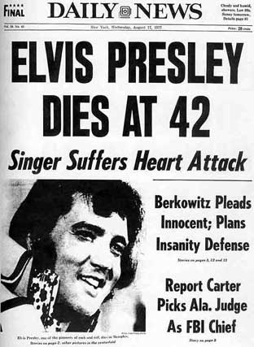
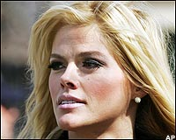
Let’s let celebrities die in peace!

Slide 60
This powerpoint was kindly donated to www.worldofteaching.com
http://www.worldofteaching.com is home to over a thousand powerpoints submitted by teachers. This is a completely free site and requires no registration. Please visit and I hope it will help in your teaching.

